Slide 1

ANOMALY DETECTION ON TIME SERIES GRAPHS
Roberto Giordano
A.A 2024/2025
Supervisor:
Karina Chichifoi

Slide 2

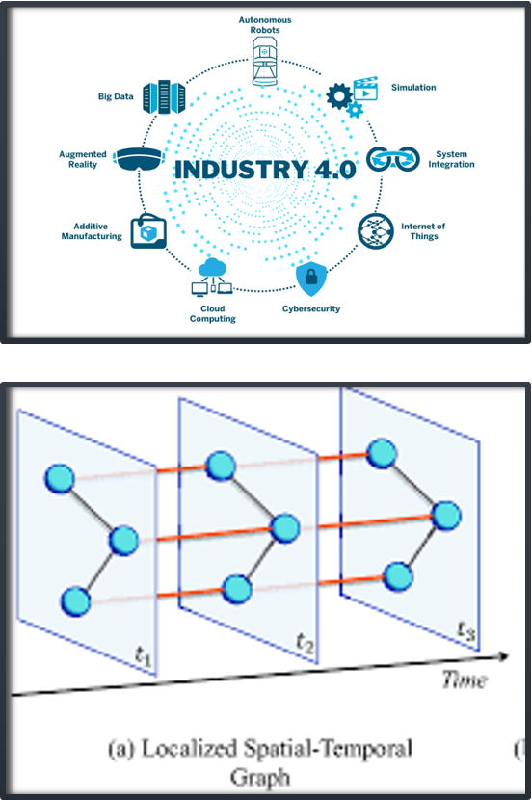
Introduction
•Industry 4.0
•Cybersecurity threats
•Anomaly Detection
•Spatial and Temporal Correlation
•Novel approach applied in this field

Slide 3

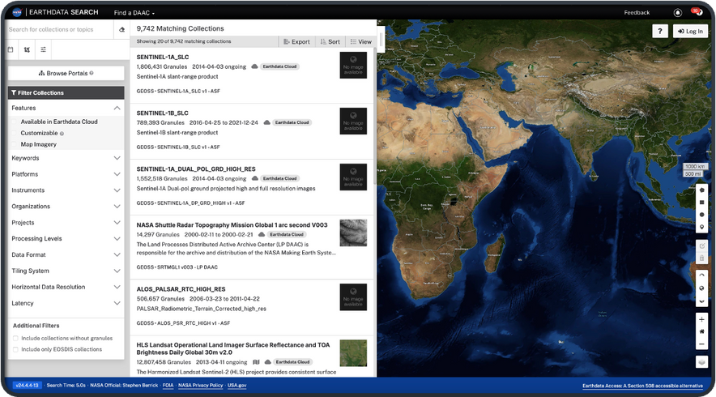
DATASET: SNDRSNML2RMS_1
•The EarthData tool
• Data Organization
1410
64.1 GB
Granules
out of 2.5 TB
8 months
Europe
across 2013 and 2015
window selected

Slide 4

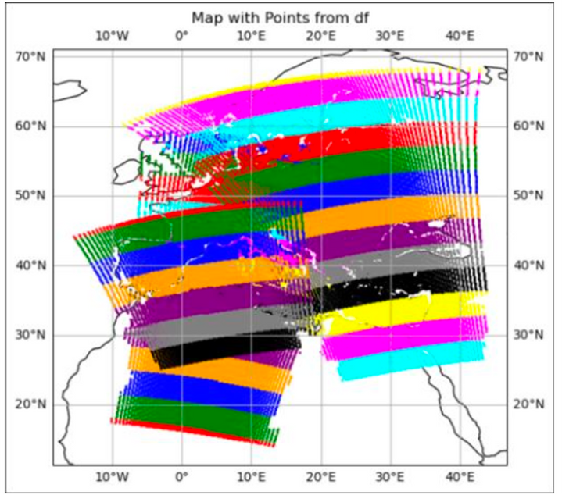
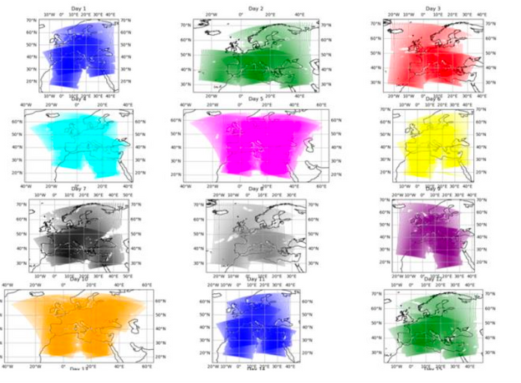
DATASET: SNDRSNML2RMS_1
•Analysis and interpretation of data

Slide 5
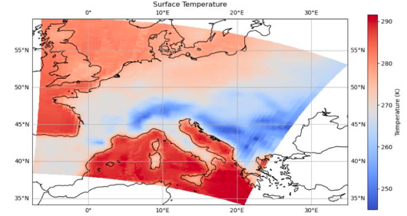
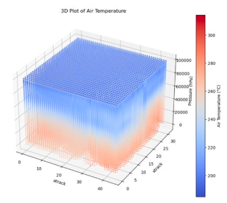
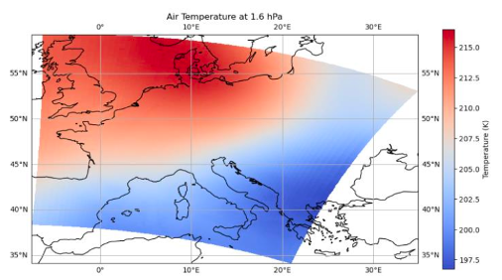
Variables
Surface temperature
Air temperature
Air temperature
at pression 1.6hPa

Slide 6
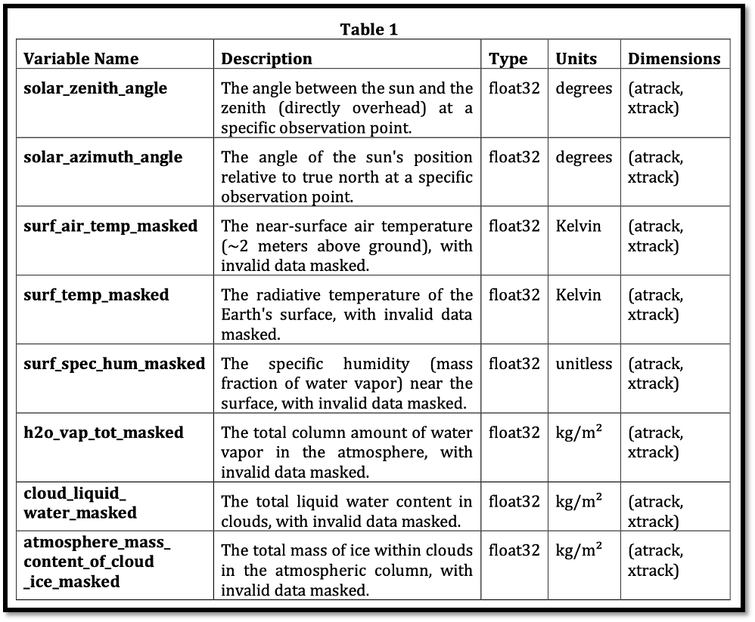
Variables Selection

Slide 7
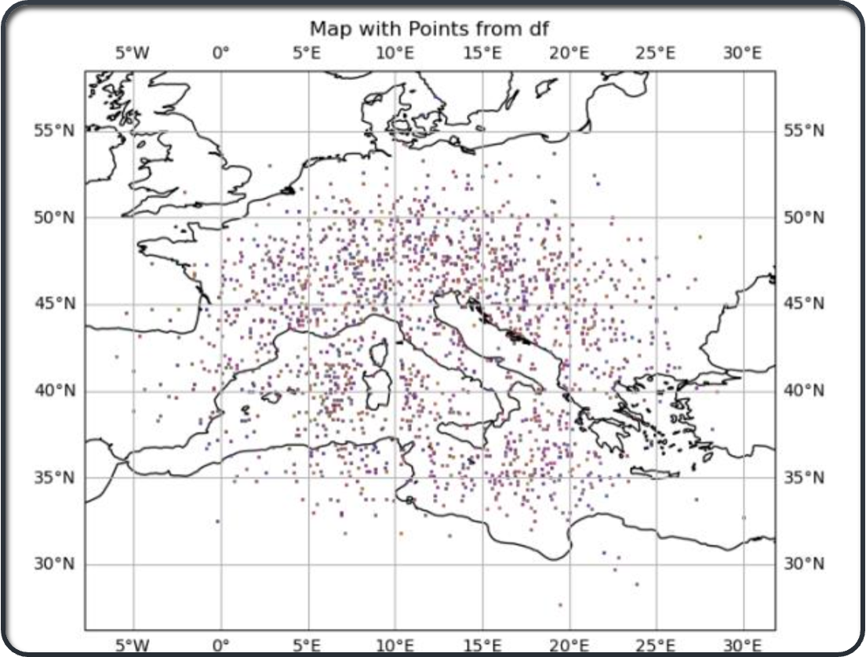
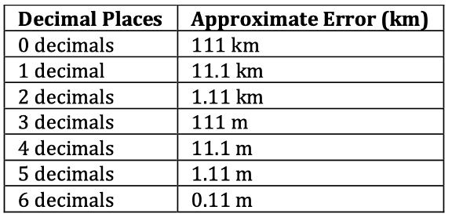
Latitude and Longitude Approximation

Slide 8

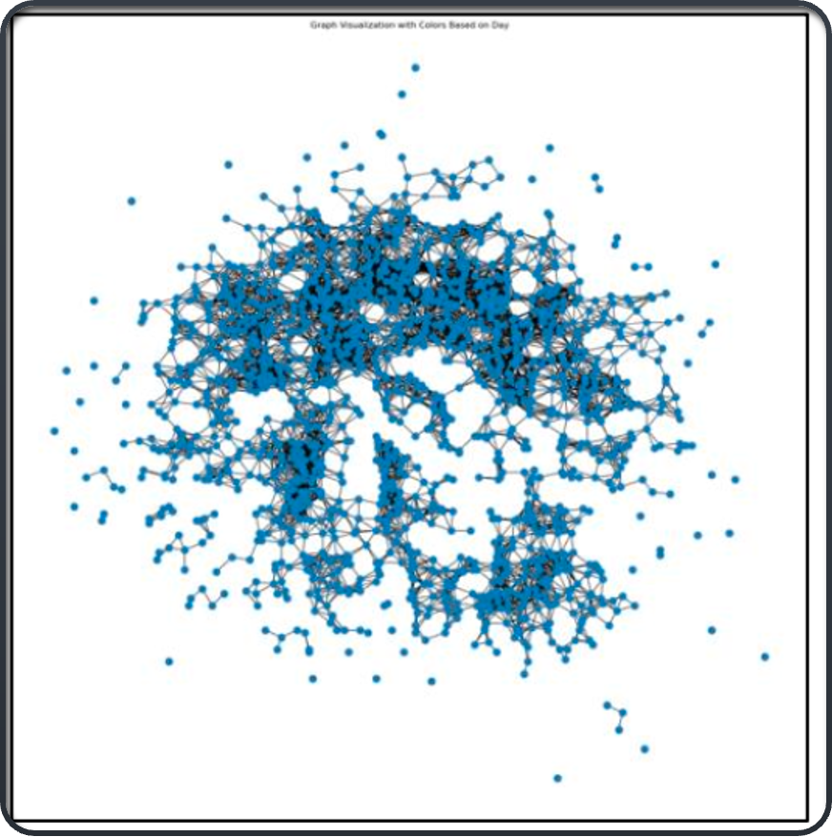
Static Graph Creation

Slide 9
Model Architecture

Slide 10

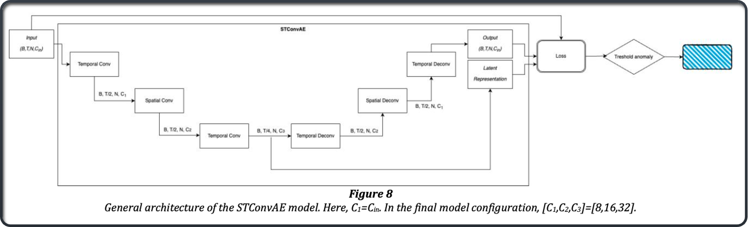
Model Architecture: overview

Slide 11
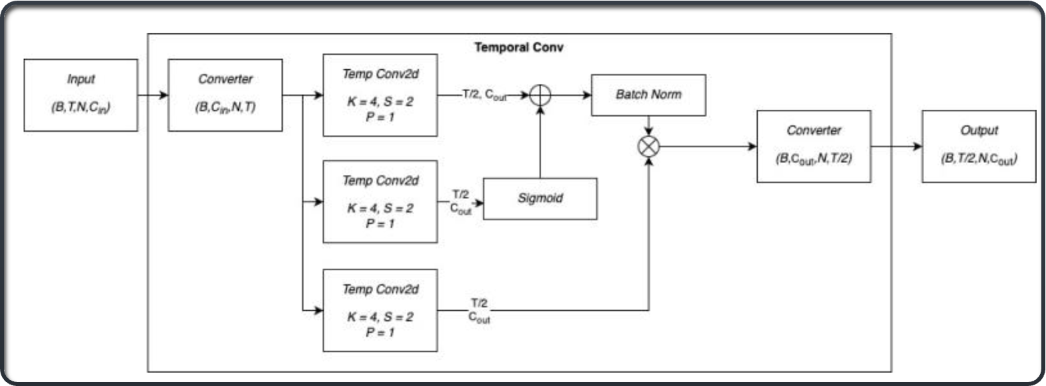
Model Architecture: temporal block

Slide 12
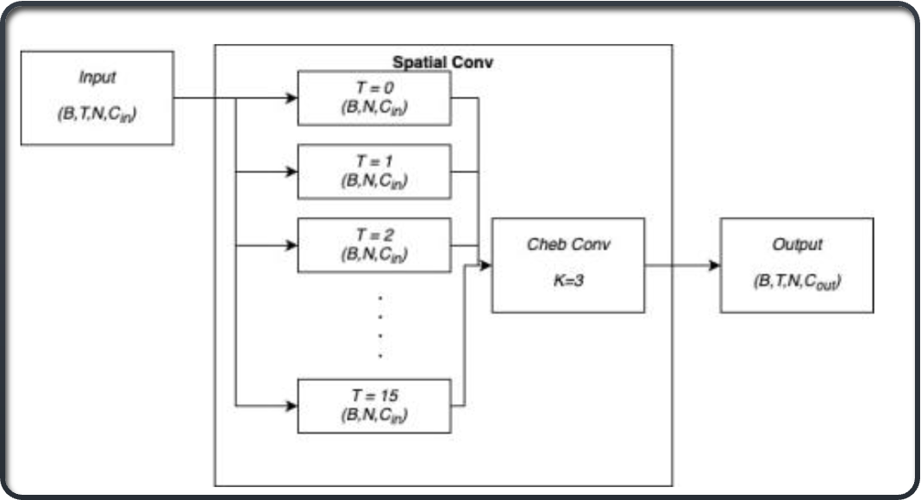
Model Architecture: spatial block

Slide 13

Experiments

Slide 14
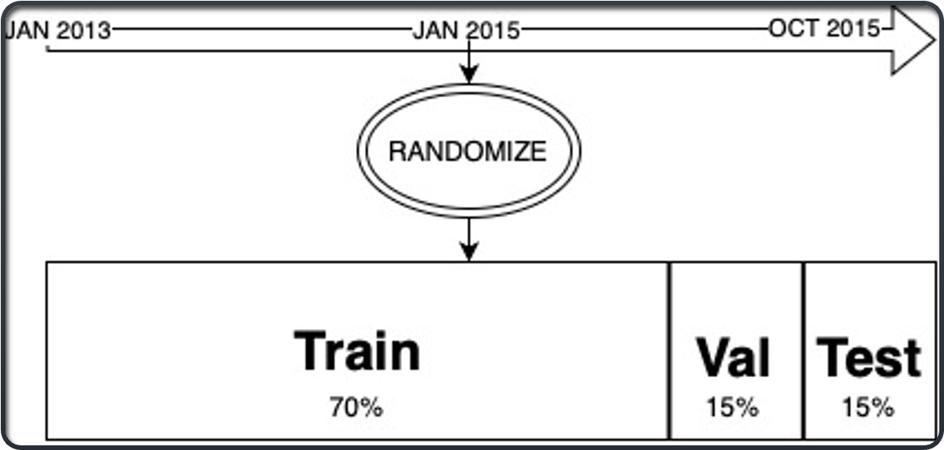
Experiments: Data Splitting Strategy

Slide 15

Experiments: Dataset variation

Slide 16

Experiments: Architectures

Slide 17

Experiments: Activation and Gate Functions

Slide 18


Experiments: Loss functions
MSE
Edge Weight Preservation
Pairwise similarity
Mean square error between input and output.
The distances of the nodes in the input must be preserved in the latent space.
Linked nodes must be similar
L1
Latent space
Weighted Function
Absolute error between input and output
MSE and/or L1 applied to latent space
Different weights for a combination of them

Slide 19
Experiments: Data input for training
01
Temporal Window
02
Batch Size
8-16-24 days
2-4-16

Slide 20
Final Architecture and Parameters

Slide 21
01
Kernel Size: 4
02
Stride: 2
03
Padding: 1
Best model configuration
04
Chebyshev Polynomial Order (K): 3
05
Gated Function: Sigmoid
06
Activation Function: Leaky ReLU (Slope 0.01)
07
Architecture: Encoder-decoder
08
Training Epochs: 150
09
Loss: Edge Weight Preservation + Pairwise Similarity + MSE
10
Dataset: subdata_extended (2013 and 2015), without augmentation.

Slide 22
Architectural Details
01
Parameters: 22976
02
Number of channels evoved through the layers: 8->16->32
03
Temporal layers halved the temporal dimension at each step.
04
Training and evaluation were conducted using a batch size of 2 for training and validation,and 1 for testing.

Slide 23
Data statistics and model Inputs:
01
Number of nodes: 1657
02
Number of features: 8
03
Temporal steps: 16
04
Train/Val/Test split: 70%-15%-15%

Slide 24
Edge Structure
01
Edge index shape: [2, 12564]
02
Edge weights shape: [12564]

Slide 25
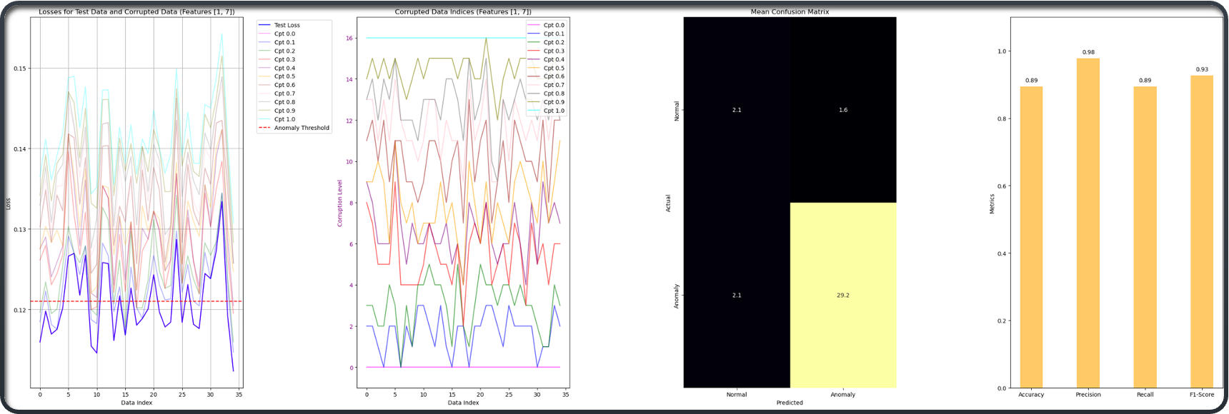
Results

Slide 26
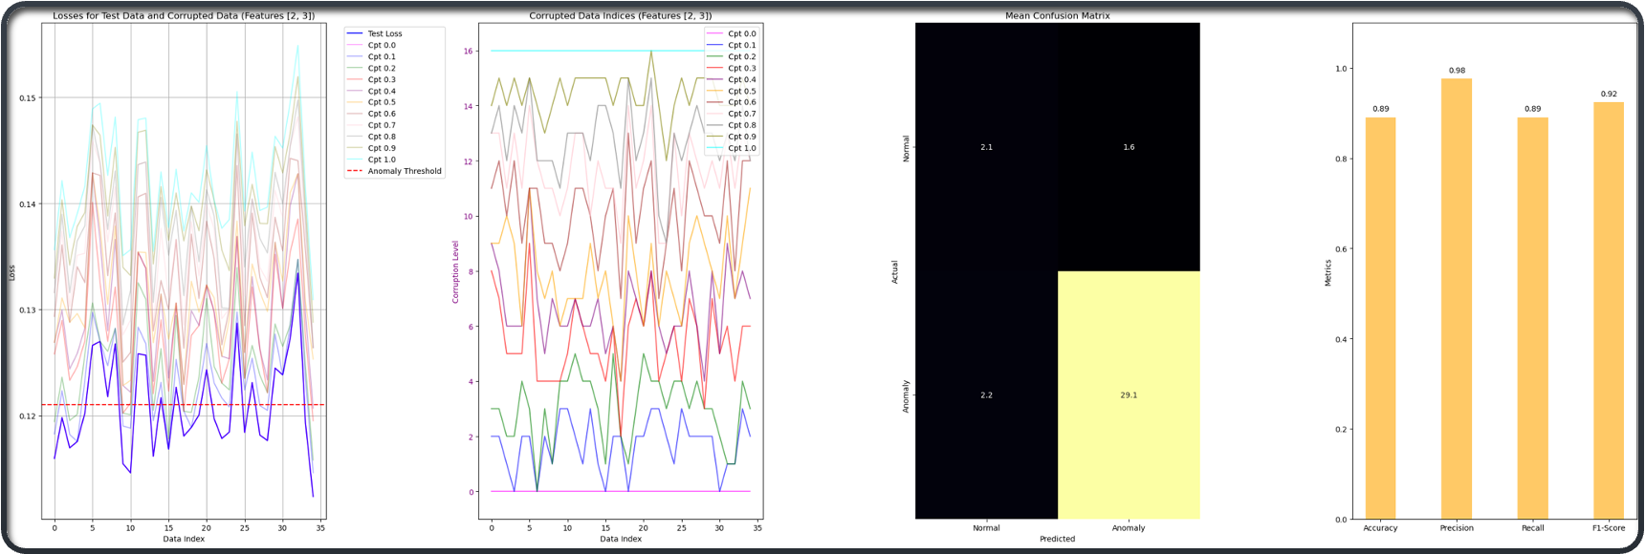
Results

Slide 27
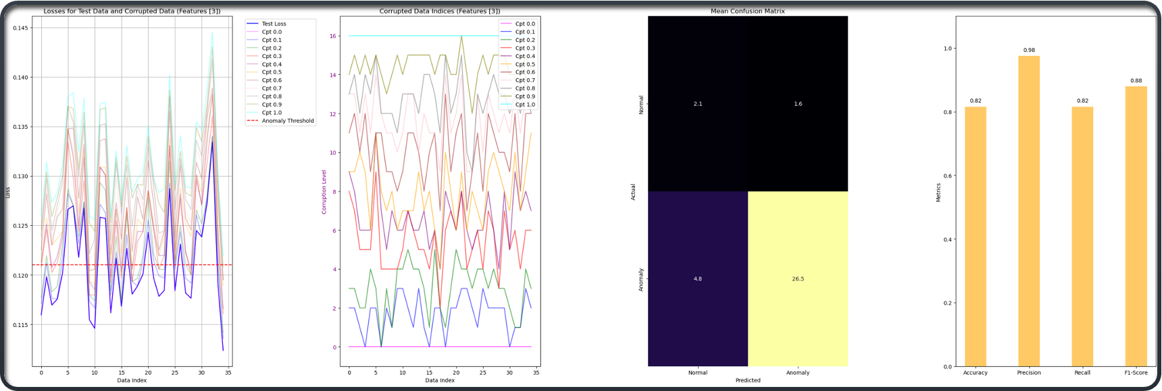
Results

Slide 28

Results

Slide 29
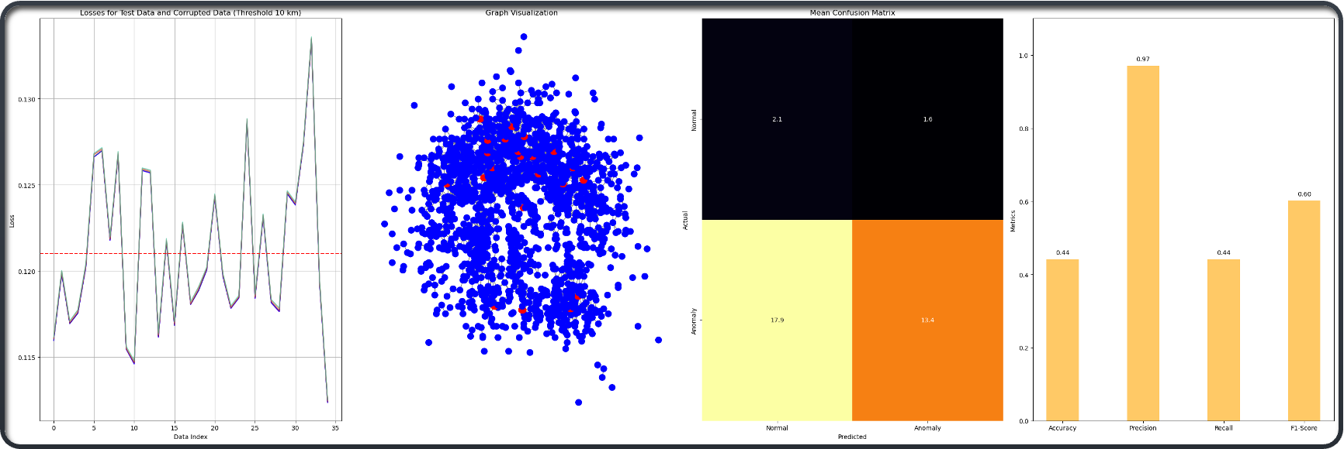
Results

Slide 30
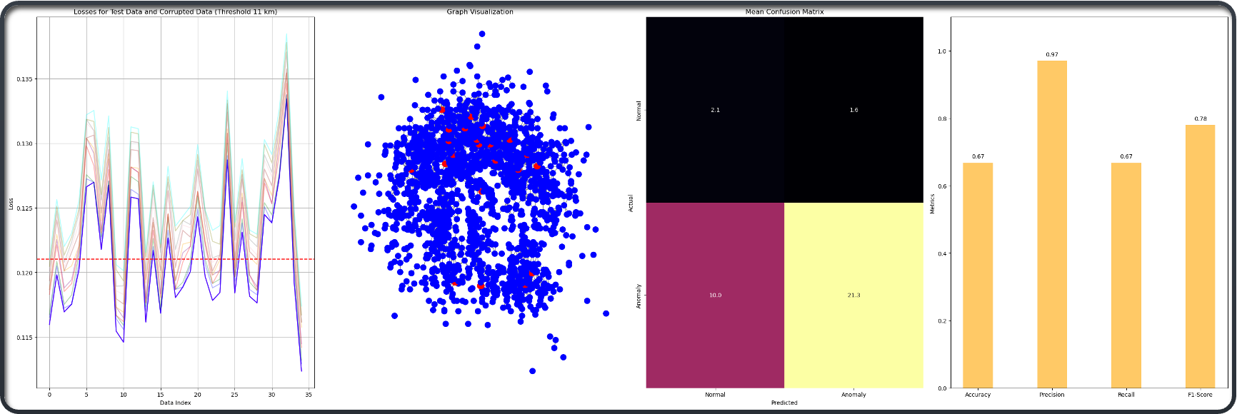
Results

Slide 31
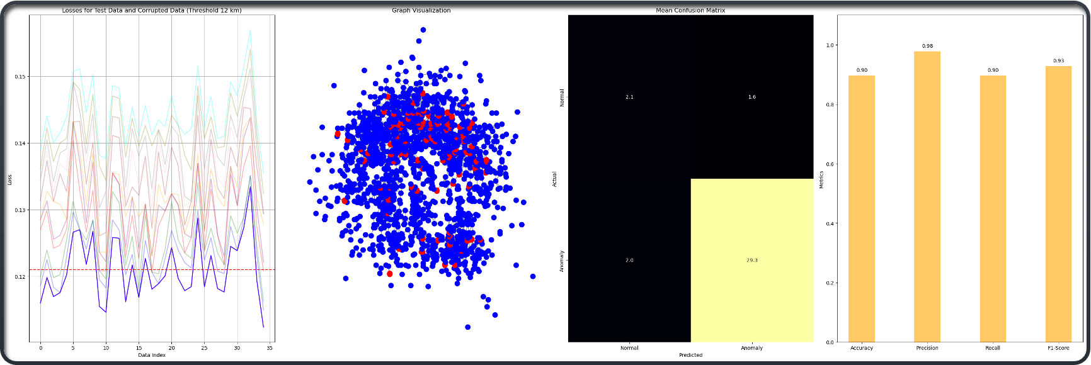
Results

Slide 32

Results

Slide 33
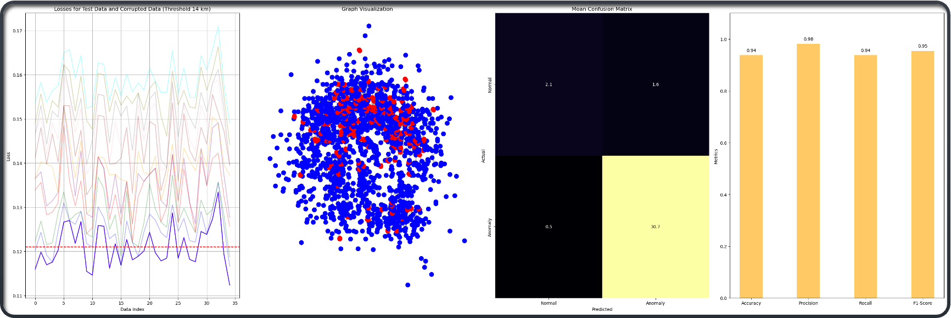
Results

Slide 34

Results

Slide 35
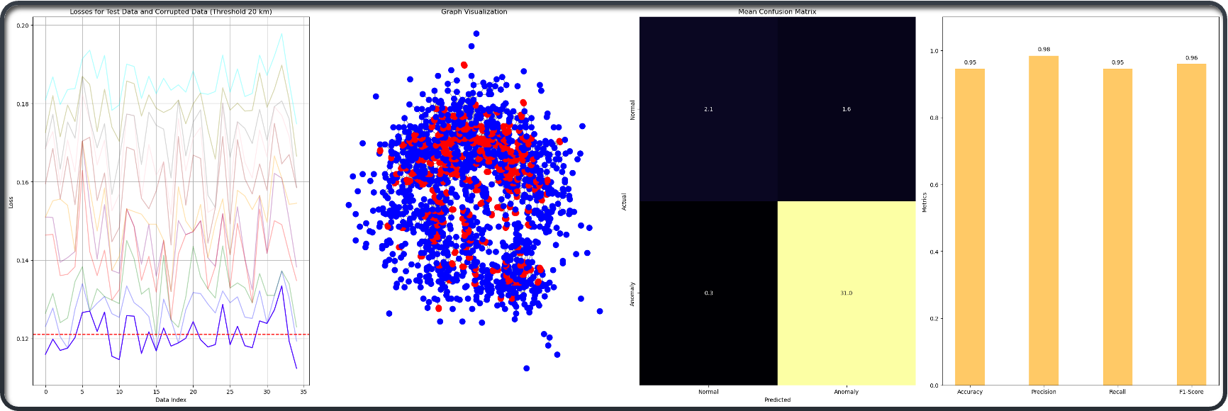
Results

Slide 36
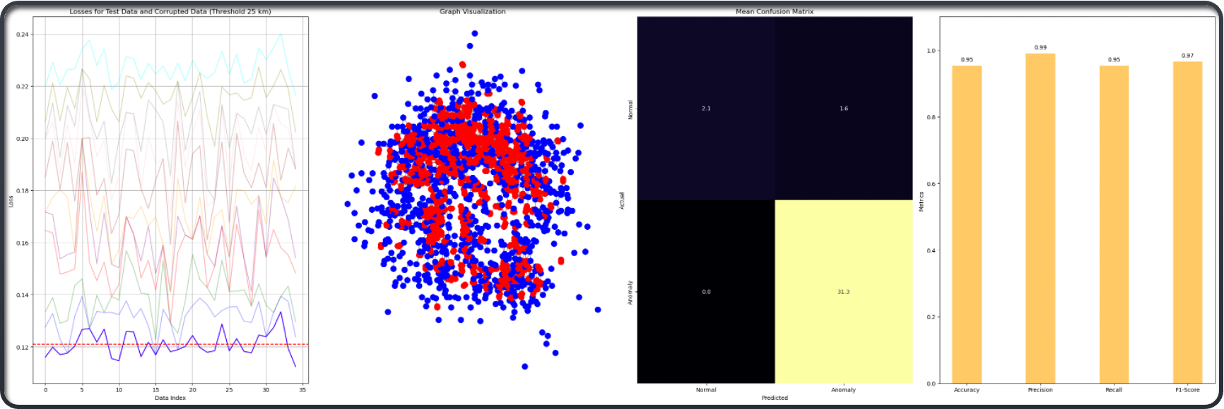
Results

Slide 37
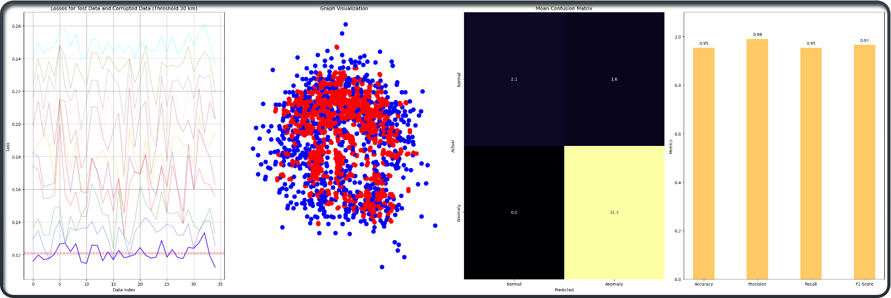
Results

Slide 38
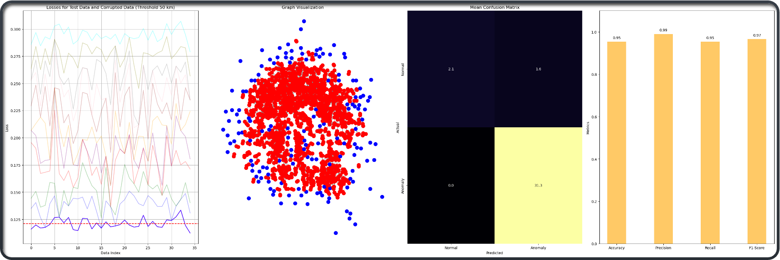
Results

Slide 39
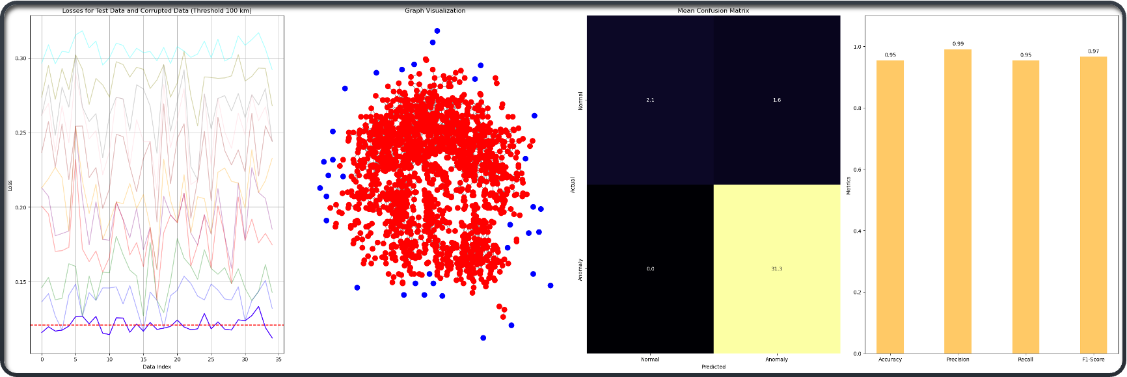
Results

Slide 40

Thank You
for Attention
Roberto Giordano
roberto.giordano2@studio.unibo.it

